Slide 1
Investigate the Relationship between Noise Complaints and Housing Cost in New York City
MGT 6203 – Team 10
Juan David Rodriguez
Evgenia Jane Bugai
Nickolas Tyler Reinig
Hisashi Kominami
Muhammad Ahmad

Slide 2
Presentation Outline
Background Information
Problem Statement
Planned Approach
Initial Hypotheses
Progress Update
References

Slide 3
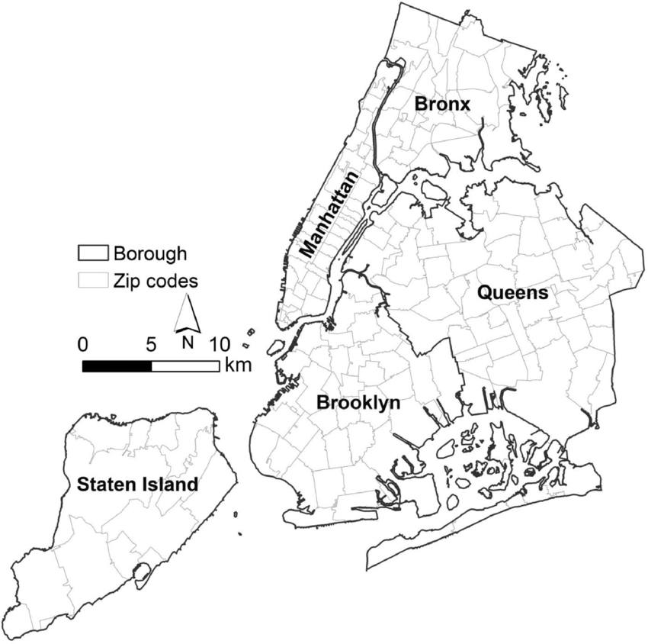
Information Background
NYC consists of 5 boroughs, such as Manhattan, Queens, Brooklyn, Bronx, and Staten Island and is home to approximately 8.5M people
According to Zillow Inc., the average cost of buying a home in NYC is $630,000 and the average rental price is $3,000 per month
In 2022, the NYC real estate market recorded around 26,000 transactions worth over $26 billion in sales and $84 billion in rental income
There are plenty of lucrative opportunities in NYC real estate market and many players including property owners, investors, and real estate firms are attempting to predict the housing market
According McKinsey’s article, “Getting ahead of the market: How big data is transforming real estate”, there is now a trend towards investigating less obvious factors to understand and forecast prices in addition to traditional prediction methods
Notes:
Presentation Requirements (from MGT 6203 Group Project Guidelines.docx):
A 4–5-minute video presentation (one presentation per team).
Team members are listed on presentation
Speakers need to mention who they are before speaking
Necessary background info/framing of the problem
Any initial hypotheses
What type(s) of models we plan to use
A progress update on:
Data preparation and cleaning
Any unexpected problems, challenges, and interesting findings
If anything isn’t working, be sure to discuss this.
Not everyone is required to present at this stage

Slide 4

Information Background (continued)
NYC is also VERY LOUD!!
20% of New Yorkers report being frequently disturbed by noise in their homes
New York City Department of Health and Mental Hygiene study found that the average levels of outdoor noise in many areas of the city are higher than both federal and international guidelines
The noise issue cannot only have a negative impact on people's health and quality of life but could also affect housing values.
https://traveltips.usatoday.com/top-5-cities-never-sleep-109183.html
Notes:
Presentation Requirements (from MGT 6203 Group Project Guidelines.docx):
A 4–5-minute video presentation (one presentation per team).
Team members are listed on presentation
Speakers need to mention who they are before speaking
Necessary background info/framing of the problem
Any initial hypotheses
What type(s) of models we plan to use
A progress update on:
Data preparation and cleaning
Any unexpected problems, challenges, and interesting findings
If anything isn’t working, be sure to discuss this.
Not everyone is required to present at this stage

Slide 5
Problem Statement
Our proposal seeks to better understand the relationship between noise complaints and housing cost in New York City, which could potentially be used by real estate professionals to predict housing prices and make better business decisions

Slide 6
Planned Approach: Data Sources
The NYC 311 noise complaint data between 2010 and 2023 that is available from NYC Open Data
Zillow Home Value Index (ZHVI) between 2010 and 2023
Zillow Observed Rent Index (ZORI) between 2010 and 2023
The estimated population by zip code from the U.S. Census Bureau
And income by zip code from the Internal Revenue Service

Slide 7
Planned Approach: Data Transformation
Extract noise complaints from the 311-dataset using the sodapy API; the rest of datasets will be downloaded in Excel
Join datasets using zip codes and month as keys
Detrend and smooth the dataset, excluding outliers or non-residential zip codes
Identify and control influential variables such as income and/or rent-controlled housing

Slide 8
Planned Approach: Methodology
Develop a linear regression model to understand the relationship between total noise complaint ratios and the house value index. Since the relationship is unlikely to be linear, we will test various transformations such as linear-log, log-linear, and log-log
Use diagnostic plots to determine which transformation provides the best fit for the data
Test regression model by comparable income groups to determine if the resulting parameters (Adjusted R-Square, diagnostic plots) improve
Use multivariate regression will be test the noise complaints ratios by type and timeframe
Test the change in complaints' ratio as a predictor of the change in t+1, t+2, and t+3 house and rent prices

Slide 9
Initial Hypotheses
Our initial hypothesis is that the intensity of noise complaints could negatively affect both the value of houses and the cost of renting, leading to lower prices.
If the hypothesis is true, this information can be used to:
Help city planners, developers, and property owners to make better business decision
Create noise rating system that can be used by online real estate platforms such as Zillow to improve search experience for users
Allow property owners and policymakers to collaborate to enhance the current noise regulations in New York City

Slide 10
Progress Update
Data preparation and cleaning
Exploratory Data Analysis
Unexpected problems and challenges
Interesting findings

Slide 11
References
McKinsey & Co. (2018, October 8th). Getting ahead of the market: How big data is transforming real estate. Retrieved from https://www.mckinsey.com/industries/real-estate/our-insights/getting-ahead-of-the-market-how-big-data-is-transforming-real-estate
New York City Department of Health and Mental Hygiene (2014). Ambient Noise Disruption in New York City. Retrieved from https://www.nyc.gov/assets/doh/downloads/pdf/epi/databrief45.pdf
New York City Department of Health and Mental Hygiene (2013). Preventing noise-induced hearing loss among young people. Retrieved from https://www.nyc.gov/assets/doh/downloads/pdf/epi/databrief45.pdf
New York City Department of Housing. (2022, May 16th). 2021 New York City Housing and Vacancy Survey. Retrieved from https://www.nyc.gov/assets/hpd/downloads/pdfs/services/2021-nychvs-selected-initial-findings.pdf

